Slide 1
Time Series : Quebec Car dataset
Time Series final project
Group 5:
Mohil J
Taha T
Vedant C
Xinyu L

Slide 2
Overview
Description of data
Data Analysis
EACF
Time series methodology application
Fitting the models
Evaluating the model
Forecasting
Holdout Set
Conclusion.

Slide 3

Describing the Dataset
About the dataset:
Data taken from Data World :
https://data.world/perceptron/monthly-car-sales-quebec-1960
The Monthly Cars Sales dataset tracks car sales in Quebec, Canada.
With 108 observations, it shows a pattern where car purchases are higher during the summer months (April/May onwards) due to the inhibiting factors of cold winter weather and snow.
Data Preprocessing
The data set has 3 columns namely Year, Month & Sales.
Data was split into train and test (90:10)
We don’t need to clean this dataset because it doesn’t contain NA values.

Slide 4
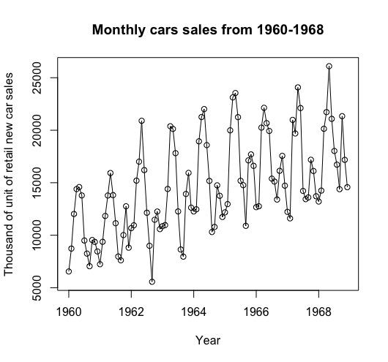
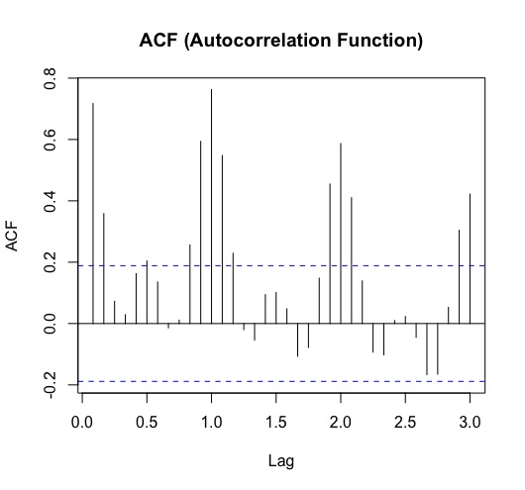
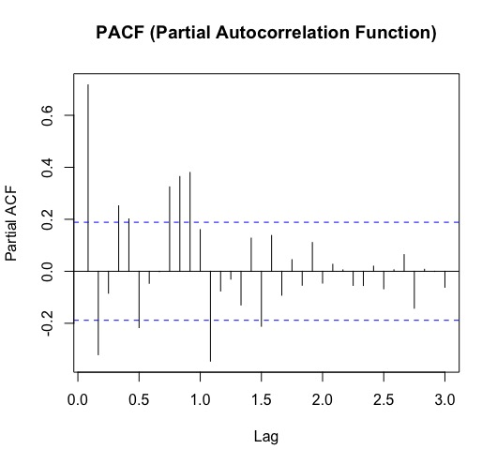
Analyzing the data
Trend: There is strong upward trend.
Seasonality: A seasonal pattern is rise and fall in data values that repeats after regular intervals. We can visualize it from the plot.
we observe non stationarity due to upwards trend
The strong correlations observed at lags 12, 24, 36 indicate the presence of a seasonal autocorrelation relationship. This will help in selecting appropriate modeling techniques, such as SARIMA, to effectively capture and account for the seasonal patterns in the time series data.
PACF indicating a significant partial autocorrelation at a seasonal lag of 12 suggests the presence of seasonality in the time series, indicating a repeating pattern every 12 periods.

Slide 5
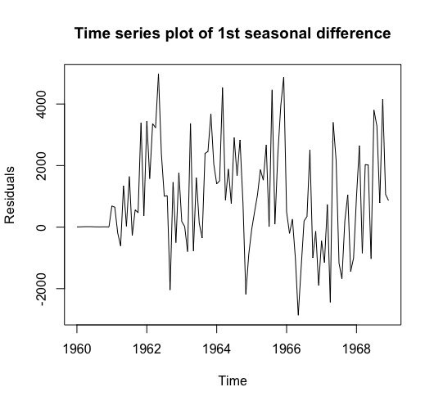
Seasonality
Seasonal ARIMA differencing:
The seasonal ARIMA model incorporates both non-seasonal and seasonal factors in multiplicative model.Shorthand notation is :
ARIMA(p,d,q)x(P,D,Q)_{s}
with p = non-seasonal AR order, d = non-seasonal differencing , q = non-seasonal MA order and P = seasonal AR order, D = seasonal differencing & Q = seasonal MA order and s is time span of repeating seasonal pattern.
Seasonal differencing is done to get rid of seasonal trend and fitting a plain model until time series and ACF/PACF plots of residuals show no sign of seasonality.

Slide 6
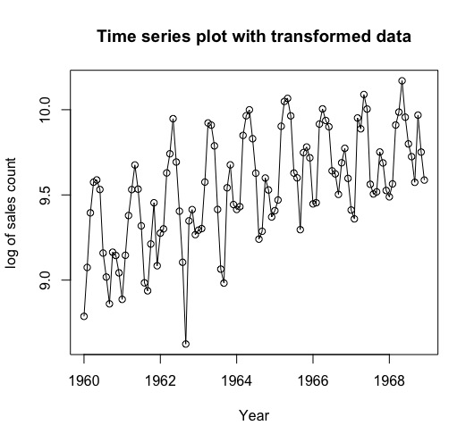
Transformation
Data transformation are important tools for proper statistical analysis .
We have applied log transformation on the time series data and plotted it on the graph.
We see an intervention point in the TS plot. Apart from it the time series look as same with upward trend.

Slide 7
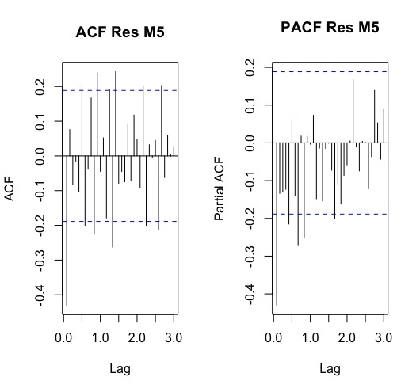
Non-Seasonal Differencing
As we don’t see any decaying pattern, we start with ordinary differencing d=1, to get rid of remaining trend and correlation in ACF/PACF plots.
We get a high correlation at 1st lag and also, we observe few significant lags. All this is due to the intervention point.

Slide 8
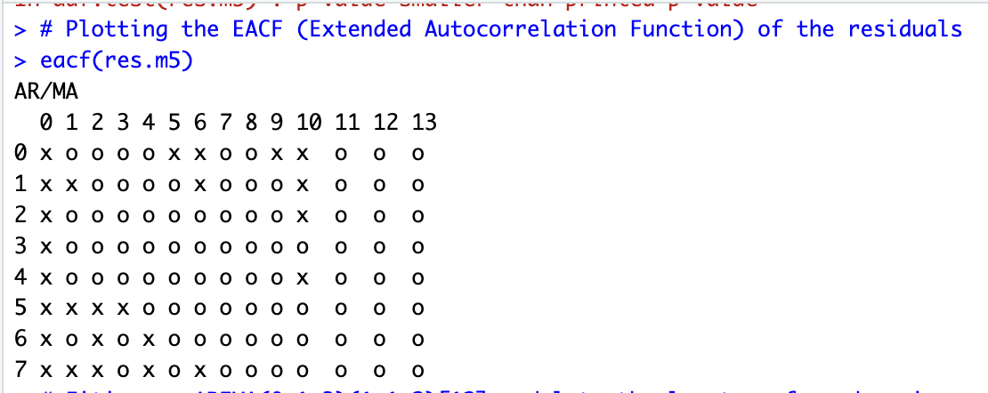
Extended Autocorrelation Function EACF
The EACF (Extended Autocorrelation Function) is a tool used in time series analysis to help identify the appropriate orders of an ARIMA (Autoregressive Integrated Moving Average) model. It provides information about the potential autoregressive (AR) and moving average (MA) components of the model.
The EACF is typically represented as a table, with the MA coefficients listed across the top and the AR coefficients listed down the side. Each cell in the table represents the value of the EACF at the corresponding AR and MA orders.
The top-left most EACF that is less than absolute value of 2 times standard error of EACF is at position that indicates good choice for orders of model.

Slide 9
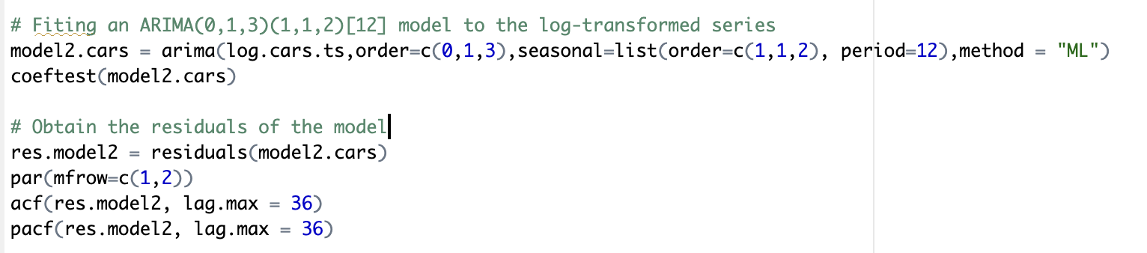
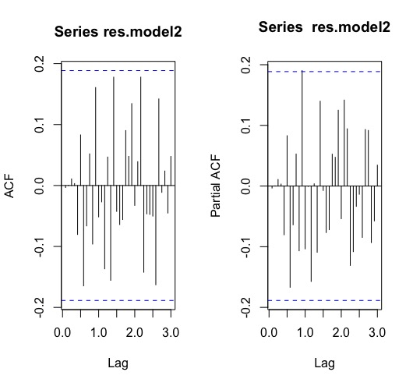
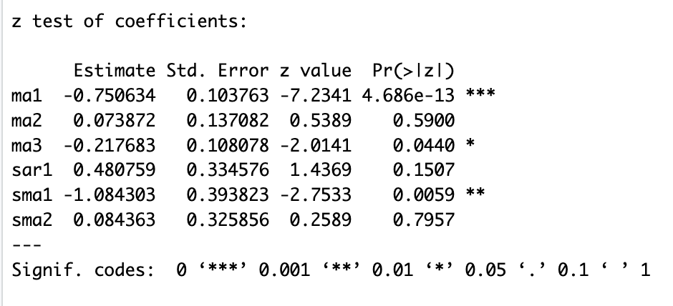
Model Fitting
The tentative models are specified as:
SARIMA (0,1,4)x(1,1,2) by ACF if we consider pacf is tailing off so we take only MA coefficient.
SARIMA (0,1,3)x(1,1,2) by ACF if we consider pacf is tailing off so we take only MA coefficient.
SARIMA (3,1,4)x(1,1,2) by ACF/PACF
SARIMA (2,1,1)x(1,1,2) by EACF
SARIMA (2,1,2)x(1,1,2) by EACF
SARIMA (3,1,2)x(1,1,2) for over fitting SARIMA (2,1,2)x(1,1,2)
ACF/PACF shows presence of white noise and this indeed is one of the good model. We further fit other models and compare at the end.

Slide 10
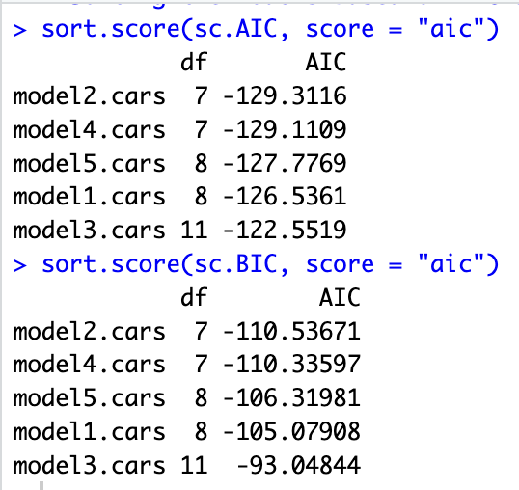
AIC & BIC
We have fitted all the set of possible models and computed the coefficient test.
Now to select the best model we can go with AIC and BIC model.
AIC gives us model2 i.e., SARIMA(0,1,3)x(1,1,2) as best model
BIC also gives us the same model2.cars i.e., SARIMA(0,1,3)x(1,1,2) as best one.

Slide 11
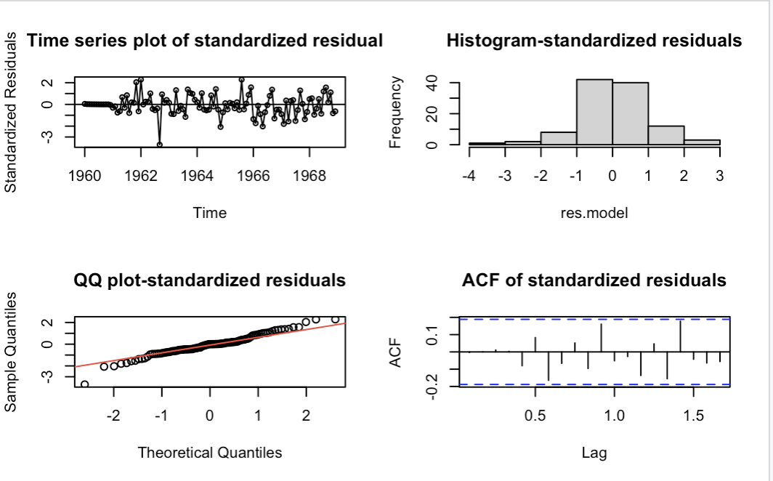
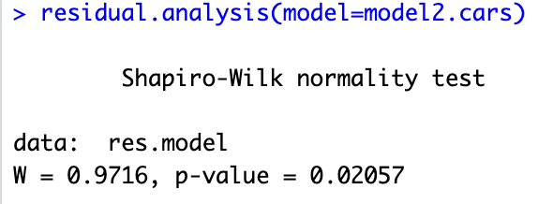
Model Diagnostics
SARIMA(0,1,3)x(1,1,2) will be used for parameter estimation, testing the significance of parameters and forecasting.
From the residual analysis of SARIMA (0,1,3)x(1,1,2) model we draw the following conclusions:
TS plots do not show any trend(as seen earlier) except an intervention point.
Histogram shows normal distribution of the residuals.
QQplot shows normality with 1 outlier at the head.
ACF plot shows presence of white noise .
W = 0.97161: The test statistic (W) is a measure of how closely the observed data align with the expected values under the assumption of a normal distribution
p-value = 0.02062: The p-value is a measure of the strength of evidence against the null hypothesis. In the context of the Shapiro-Wilk test, the null hypothesis is that the data are normally distributed.
Based on the provided results, we can interpret the Shapiro-Wilk test as follows:
Since the p-value (0.02062) is less than the significance level of 0.05, we have sufficient evidence to reject the null hypothesis that the data follow a normal distribution.
Therefore, we can conclude that the dataset "res.model" does not follow a normal distribution.

Slide 12
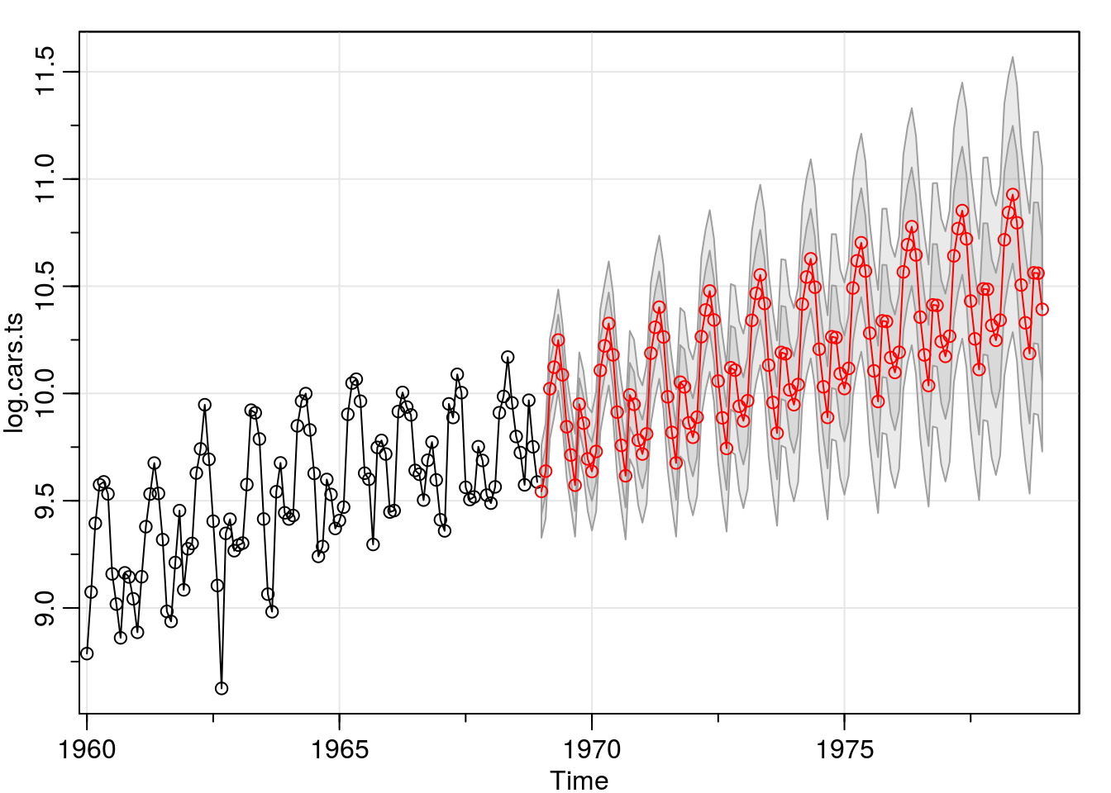
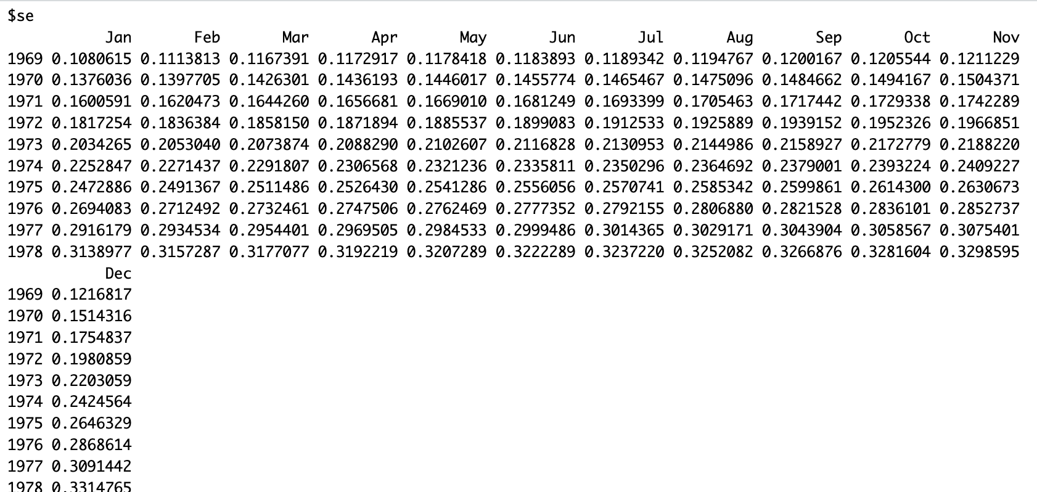
ARIMA Forecasting - Car's sales for next 10 years
When considering elements like advancing technology, population expansion, and other factors that are driving forces in the automobile sector, an upward trend in auto sales is actually in accordance with forecasts.
While an upward tendency in car sales is frequently seen, it's crucial to remember that this trend may not be linear or consistent. The growth rate and trajectory of car sales over time can be influenced by economic conditions, consumer preferences, governmental regulations, and other external factors. As new information becomes available, it is crucial to regularly check and update the forecast.

Slide 13
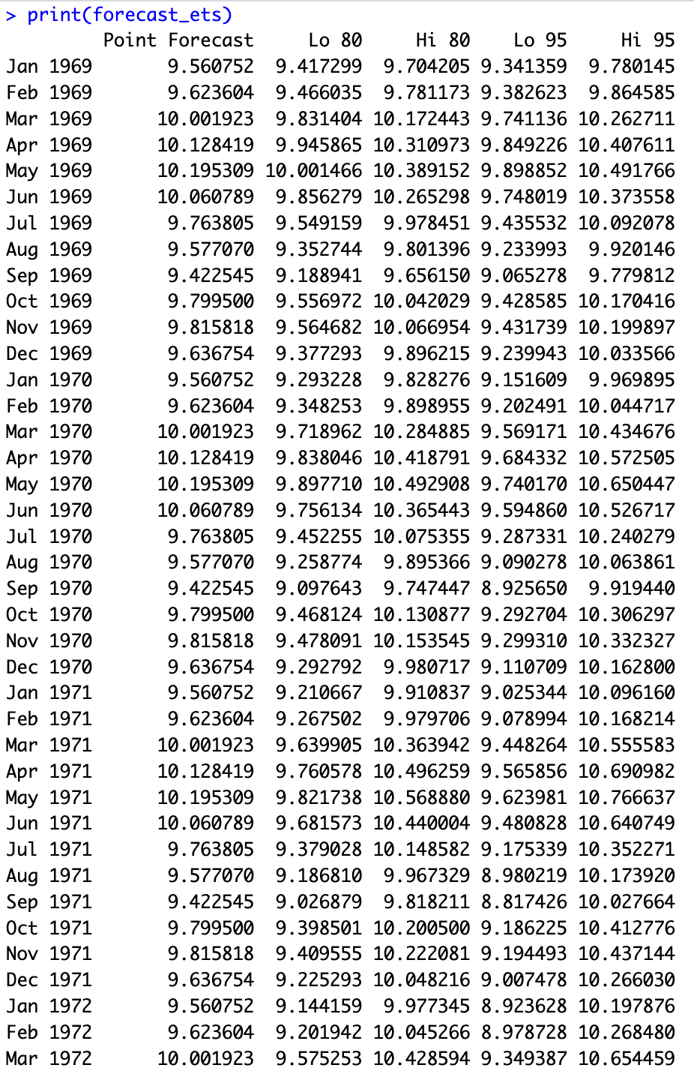
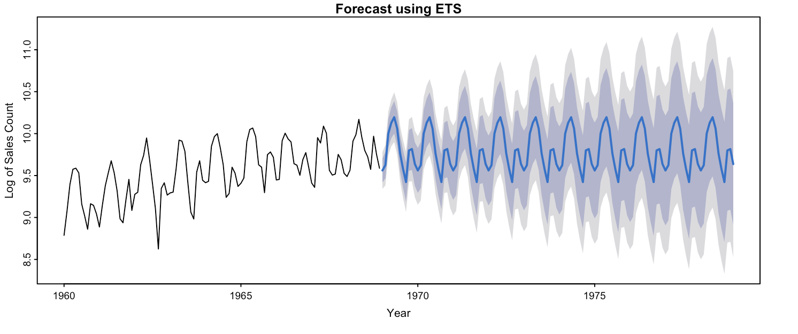
ETS Forecasting - Car's sales for next 10 years

Slide 14
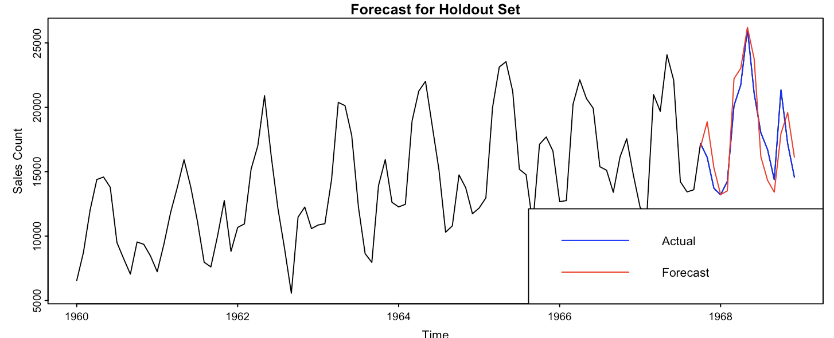
Holdout Set
The forecast evaluation metrics for the model can be summarized as follows:
The forecasted values have a Mean Error (ME) of -326.0715, indicating an average underestimation of the actual values by 326.0715.
The Root Mean Squared Error (RMSE) is 1890.567, representing the average magnitude of the forecast errors.
The Mean Absolute Error (MAE) is 1605.943, indicating the average absolute difference between the forecasted and actual values.
The Mean Percentage Error (MPE) is -1.934996, indicating an average underestimation of 1.93% in the forecasted values.
The Mean Absolute Percentage Error (MAPE) is 9.121624, representing the average absolute percentage difference between the forecasted and actual values.
The Autocorrelation of Residuals at Lag 1 (ACF1) is 0.08926692, indicating little or no autocorrelation in the residual errors.
Theil's U measure is 0.5338185, indicating a moderate level of accuracy for the forecasted values compared to a naive forecast.

Slide 15
Summary
Investigated seasonal ARIMA model and ETS model We then proceeded with the approach of time series modelling: Model specification
Residual approach
Model fitting
Model diagnostics
Using our model to predict the future 10 years, we discovered that SARIMA (0,1,3)x(1,1,2) is the best model.

Slide 16
Thank You

